Slide 1
Are Your Kids Worried?
How to Tell.
What to Do.
Cheryl D. Goldberg, MA, LCMHCS, LCAS
Certified Brainspotting Practitioner
Associate Director, Therapy Services
Mood Treatment Center

Slide 2
What are we talking about?
Have you ever wondered if there’s a difference between fear, worry, and anxiety? Or why your kids may ask the same question or type of question over and over? What about why they may seemingly appear fine but then suddenly they’re irritable, clingy, tearful, or don’t feel well?
We have some answers for you! There is a difference between fear, worry, and anxiety and children are often worried and anxious but don’t have the words to tell us. Our goal is to provide you with information on the differences between anxiety, worry, and fear; help you identify when your kids might be experiencing worry, and some tips and resources on how to help.

Slide 3
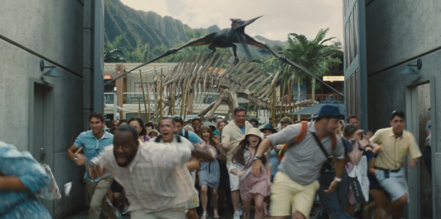
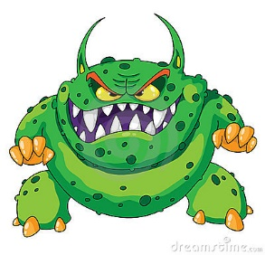
Fear
What is it?
Common Childhood Fears
Fear is about survival. It’s instinctive, universal, and there are common fears we all share.
Below 2: loud noises, strangers, high places, separation anxiety
2-3 years: fear of the dark, fear of small animals
5 years: “mean” people, bodily harm
6 years: weather, supernatural (monsters, ghosts), sleeping alone
7-8 years: fears based on media reports
9 years: school performance, appearance, death

Slide 4
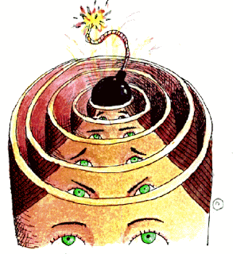
Fears versus Worries versus Anxiety
Worries are a preoccupation with “what-ifs” - thoughtful dread
Over time, our brain may begin responding to worry as if we’re in danger. This is anxiety.
Anxiety is the fear response created in our brain and sent to our body to help us survive. Fight, Flight, Freeze.
Notes:
A 1960 study (Gibson, E. J., & Walk, R. D. (1960), The "visual cliff." Scientific American, 202, 67– 71) of depth perception among babies 6-14 months old and young animals indicated that the fear of falling is an instinct necessary for survival across species. Other fears related to survival are learned such as fears of spiders and snakes (https://www.childstudycenter-rutgers.com/research). Fear is physiological and based in survival.

Slide 5
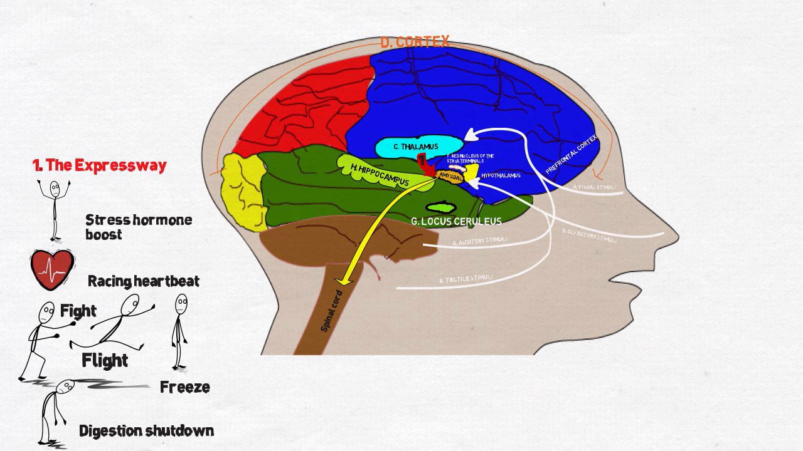
The Brain – Fight, Flight, Freeze
Visual
Olfactory
Auditory
Tactile
Notes:
Stimuli from eyes and ears flows directly to the thalmus – which is involved in projecting signals to the amygdala and neofrontal cortex for higher reasoning. Stimuli from nose and environment flow directly to amygdala which detects fear and triggers an emergency response.

Slide 6

When Do Fears Become Worries or Anxiety?
Fears become worries when we’re thinking about them but not in the presence of them.
These thoughts take on a repetitive quality and are sometimes hard to stop.
Kids are sometimes scared – of the dark for instance – but not worried.
Kids may be worried – first day of school - but not anxious.
Anxious kids always worry.

Slide 7
How To Tell

Slide 8
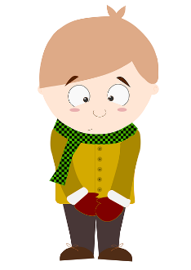
Signs of Worry
Repeated “what if” questions
Imagining the worst
Tearful
Bad dreams
“Should” statements

Slide 9
Signs of Anxiety
Somatic complaints
Nightmares
Bedwetting
Avoidance
Irritability
Tantrums
Oppositional or defiant behaviors
Trouble sleeping
Difficulty concentrating
School refusal
Inflexibility
Separation anxiety

Slide 10
SCARED
Parent and Child version
41 statements
Rate answers Not True, Somewhat True, Very True
Covers areas of: Panic, Separation Anxiety, Generalized Anxiety, Social Anxiety, School Avoidance
Answers may indicate presence of anxiety related disorders
Screen for Child Anxiety Related Disorders
Notes:
Developed by Boris Birmaher, M.D., Suneeta Khetarpal, M.D., Marlane Cully, M.Ed., David Brent, M.D., and Sandra McKenzie, Ph.D., Western Psychiatric Institute and Clinic, University of Pittsburgh (October, 1995)

Slide 11
Questions?

Slide 12
What To Do

Slide 13
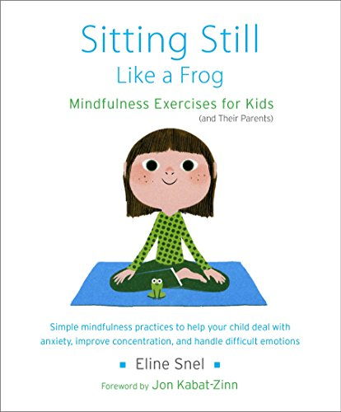
Tools
Mindfulness
Diaphragmatic breathing
Body scans
Progressive muscle relaxation
Use your senses
Kid friendly yoga
Meditation
Worry bottles
Story telling
Changing your thoughts
Vergence
Resource gazespotting
Notes:
Sitting Still Like a Frog, Eline Snel, for kids 5-12

Slide 14
Mindfulness: What is it?
“Paying attention to something, in a particular way, on purpose, in the present moment, nonjudgmentally.” - Kabat-Zinn, 2003
“Being aware of what’s happening as it’s happening.” - Kaiser-Greenland, 2006
Paying attention to your life, here and now, with kindness and curiosity.” - Saltzman, 2011
“Paying attention to what’s going on right here, right now inside of us or outside of us.” -Burdick, 2013
Notes:
Mindfulness Skills for Kids and Teens, Burdick, 2014, pg. 21 https://www.barnesandnoble.com/w/mindfulness-skills-for-kids-teens-debra-burdick/1120008792

Slide 15
Why is it Helpful?
Research shows that mindfulness practice changes the structure of the brain and improves brain functioning overall; even creating new neural pathways.
The prefrontal cortex is involved in executive functioning – planning, organization, attention regulation, decision making, behavior moderation, motivation, and mood regulation (all areas impacted by anxiety). One study shows that mindful breathing increases activation in the prefrontal cortex which could be helpful in processing emotion, such as anxiety.
Mindfulness practice helps to decrease the density of the amygdala – the part of the brain in the limbic system that’s associated with fear and emotional (implicit) memory – which reduces stress overall.
Notes:
Mindfulness Skills for Kids and Teens, Burdick, 2014, pgs. 32, 36, 39, 58
When the amygdala is activated information from the prefrontal cortex is hijacked and PFC function is impaired – which means it’s harder for kids to regulate emotion, attention, and behavior. This is why anxious kids often look as though they have ADHD.

Slide 16
What’s the Process?
Decide what to pay attention to.
Notice when you’re not paying attention to it.
Accept without judgement that you’ve been distracted.
Dismiss what’s distracted you.
Return your attention to what you’re paying attention to.
Notes:
Mindfulness Skills for Kids and Teens, Burdick, 2014, pg 77

Slide 17
Mindful Breathing
Remember watching a baby breathe? Their bellies rise and fall. They’re breathing from their diaphragm.
Place your hand on your belly, just above your belly button. Breathe in, notice your belly expanding, hold your breath for a few seconds, breathe out.
Diaphragmatic Breathing

Slide 18
Body Scans &
Progressive Muscle Relaxation
Body scans involve noticing the different parts of your body in a slow, quiet manner, and giving yourself the opportunity to be aware of what sensations are occurring.
Progressive muscle relaxation involves tensing and loosening different muscle groups throughout your body. One way is to do this very slowly, one muscle group at a time. Another is to do it quickly, tensing all your muscles (uncooked spaghetti) and then loosening them at once (cooked spaghetti).

Slide 19

Using Your Senses- step into the photo
What do you see?
What would you smell?
What could you touch? How would that feel?
What would you hear?

Slide 20
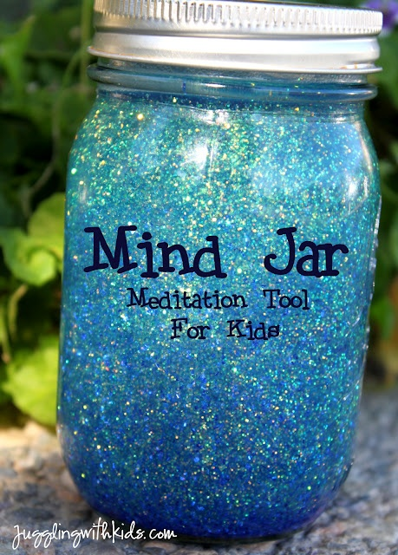
Calm Bottle
Use a clear water bottle with the labels removed (a small jar works as well)
Fill the bottle or jar up with water
Begin with 1 tsp of glitter; add more if/as needed
Make sure the lid is on tightly!
Shake the bottle and watch what happens as the glitter moves around. What can you see?
The more anxious you are, the more your mind and body are like the shaken bottle – glitter swirling everywhere making it hard to see
Practice your mindful breathing while watching the glitter settle. Notice your mind and body settling in the same way.
Bottle
Water
Glitter

Slide 21
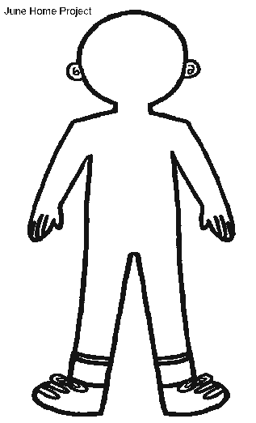
Body Awareness
Use markers/crayons to identify different feelings.
Where do you feel those in your body?
Notes:
Feelings Voc chart: From Skills Training for Kids with Behavioral Problems: A Parent, Practitioner Guidebook, M. Bloomquist, 2006

Slide 22
Other Tools – Changing Unhelpful Thoughts
Thought: My friend hasn’t talked to me; she must be mad at me.
Feeling: Sad, anxious, hurt
Behavior: I ignored my friend.
New Thought: My friend might not be mad at me. She might be upset about something else or she might be busy.
New Feeling: Worried about how she is.
New Behavior: Ask if she needs help.

Slide 23
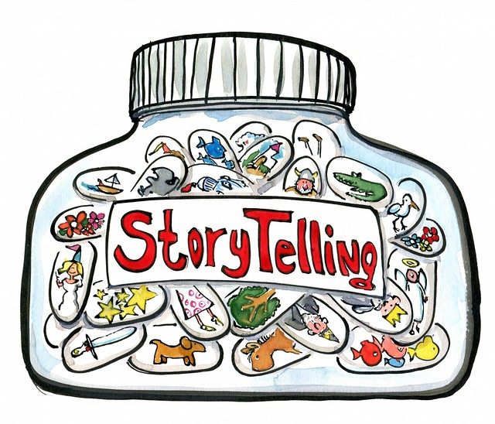
Other Tools: Story Telling
Using story telling to reframe worries by changing the ending of the story.

Slide 24
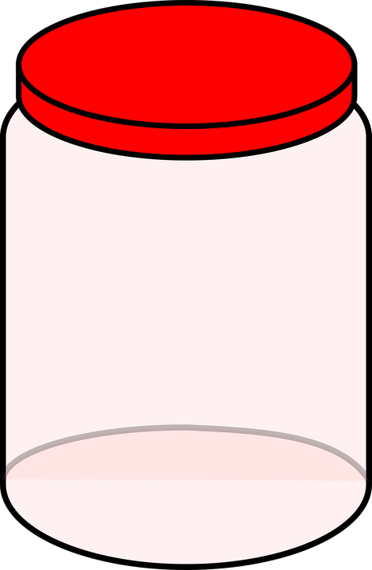
Worry Jar
Cheryl’s Worry Jar
Write worries once each day on a slip of paper and leave them in the jar.
I’m scared something bad will happen
I’m scared of the dark
I’m worried about going to college
Will there be a storm?
I’m worried I’ll get into trouble
I’m worried my mom will die
I’m worried about the coronavirus.
I’m worried about passing my test

Slide 25
Other Tools: Diffusion
Create a worry monster, draw it, name it, and use it to differentiate the worry monster’s thoughts from your kids thoughts.
We all need a our anxiety monster. It helps to keep us safe by looking across the street, studying a little harder for our test, and running a little faster when we need to. It’s when we overfeed our monster that we have problems.

Slide 26

Other Tools: Vergence
Hold a pen or some other object about 6 inches from your face. Move your eyes from the pen to a spot in the distance behind the pen. Move back and forth quickly between the two every 3-10 seconds. This serves to activate the parasympathetic nervous system and slows down the anxious response.
Notes:
In the 1970’s William Ludlum did some research on oculocardiac reflex – moving eyes quickly from near to far = this directly activates the vagus nerve, the parasympathetic nervous system, and results in a slowing of the heart. It’s very helpful in treatment of panic attacks.
Treatment of Panic Attack with Vergence Therapy, Bowan, Journal of Behavioral Optometry (2008, v. 19, no 9, pg 155)

Slide 27
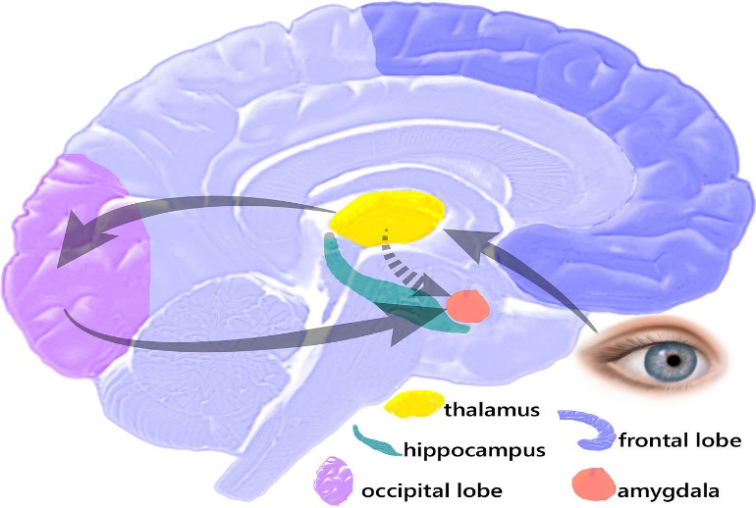
Other Tools: Resource Gazespotting
Where you look affects how you feel. Our eyes are taking in information all the time and orienting us in time and space. There’s one track from our occipital nerve to the deep part of our brain – the thalmus – which signals the amygdala to turn down the flight/flight/freeze response.
Find a quieter, calmer place in your body.
Look left, right, center.
Track up, down.
Continue gazing in the spot that increases the quieter, calmer feeling while noticing that quieter, calmer place in your body.

Slide 28
COVID 19

Slide 29
COVID 19
The National Child Traumatic Stress Network has developed a great handout geared towards supporting children during this time. The important take aways include:
Opening a conversation. There’s a common misperception that not talking about it reduces fear and worry but the opposite is true.
Correcting misinformation. This is crucial. Whether we know it or not our kids are developing their own ideas about what’s happening and these ideas are most often full of incorrect information.
Encouraging questions and answering them directly.
Validate their feelings.
Help kids and teens self-regulate, i.e., mindfulness is great!
Limit media exposure.
Notes:
https://www.nctsn.org/sites/default/files/resources/fact-sheet/supportingchildren-covid-factsheet.pdf

Slide 30
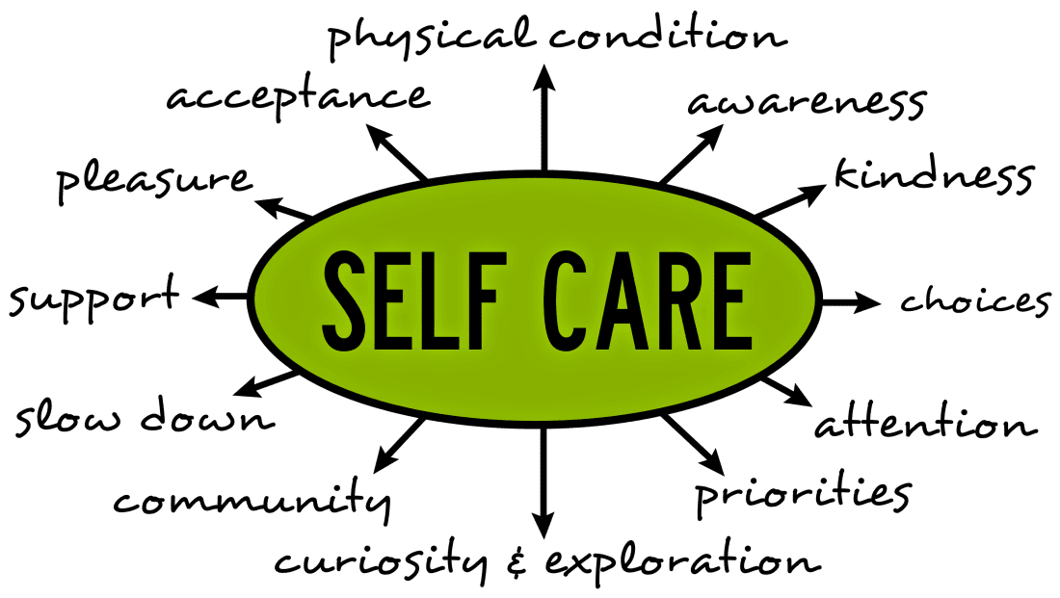
COVID 19
Stay connected!
Create routine
Practice self-care
https://www.nctsn.org/sites/default/files/resources/fact-sheet/supportingchildren-covid-factsheet.pdf

Slide 31
Words and Pictures From Real Worried Kids

Slide 32
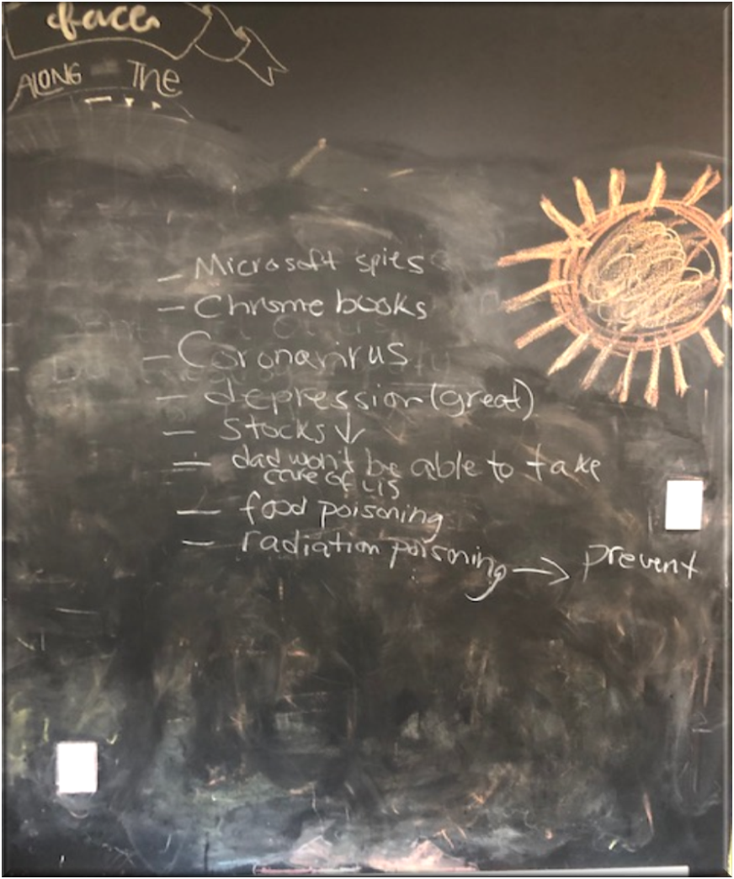
What I’m anxious about
“Not being able to see other people like my family members and friends. Society failing.”

Slide 33
Where do I feel anxious?

Slide 34
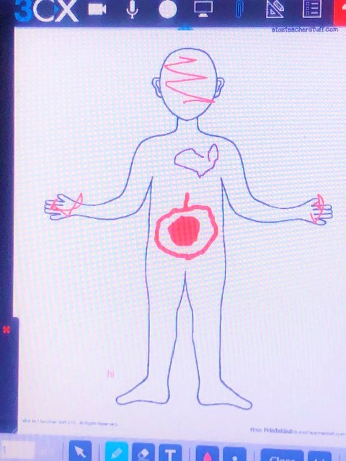

Slide 35
How Anxious am I?

Slide 36
Feeling Soup

Slide 37
What happens When I’m anxious?

Slide 38
What happens when I’m anxious?

Slide 39
What happens when I’m anxious?

Slide 40
What happens when I’m anxious

Slide 41
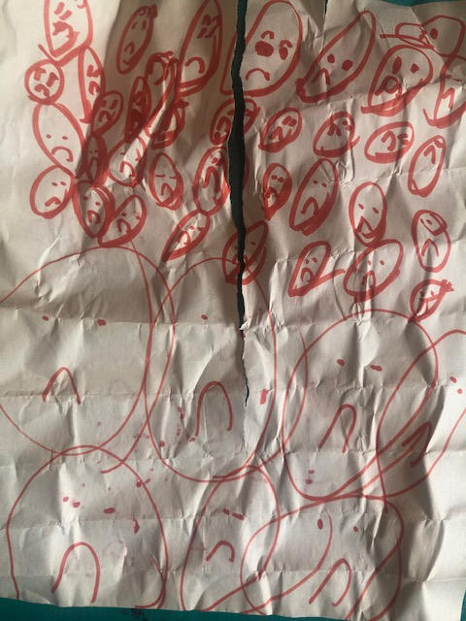
How I feel when I’m anxious

Slide 42
Overfed Worry Monster

Slide 43
Just Right Monster

Slide 44
What Helps?
“To sit next to my dog. He calms me and makes me good.”
“Hearing a funny story.”
“Someone to listen to me.”
“A hug.”
“My cat. He was a little friend that was there. I didn’t have to talk, he was just my friend and I knew he loved me.”
“My blankie, when I was really small.”
“Being with my mom.”

Slide 45
What Helps?
“Playing my video games.”
“Reading certain books, like The Hobbit, Harry Potter; things that take your mind do a different place.”
“I liked to watch a lot of sci-fi. They were cool and they kept my mind off the world for an hour or so.”
“Talking to my friends.”

Slide 46
Resources

Slide 47
Mindfulness
Mindful Ozzy Introduces Mindfulness:
https://www.youtube.com/watch?v=0k_R7R1gIdA
Calm Kids: Full Body Stretch
https://www.youtube.com/watch?v=xELgfiXSw-s
Calm Kids: Breathing and Stretching
https://www.youtube.com/watch?v=cyvuaL_2avY
Meditation videos for kids:
https://awakeandmindful.com/best-meditation-videos-for-kids/
3 Minute Body Scan Meditation
https://www.youtube.com/watch?v=ihwcw_ofuME
Calm Compliation
https://www.youtube.com/watch?v=iEEJT9cYsm0
Just Breathe: A Documentary on Kids and Mindfulness
https://www.doyou.com/just-breathe-a-documentary-on-kids-and-mindfulness-31335/

Slide 48
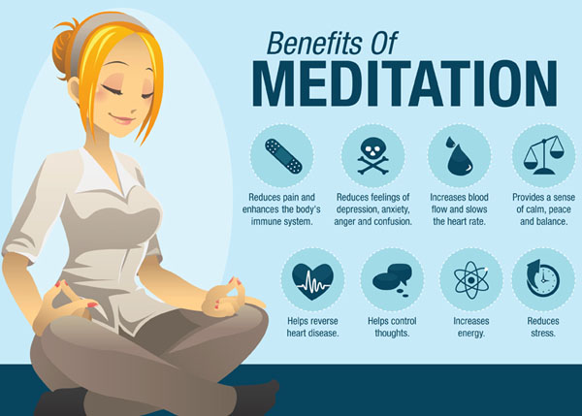
More Mindfulness
Yoga for Kids:
https://www.youtube.com/watch?v=X655B4ISakg
https://www.youtube.com/watch?v=4ZpkRAcgws4
https://www.youtube.com/watch?v=LhYtcadR9nw

Slide 49
Books For Parents, Teens, and Children
The Worried Child (Paul Foxman)
Mindfulness Skills for Kids and Teens, A Workbook (Debra Burdick)
The Mindful Child (Susan Kaiser Greenland)
Sitting Still Like a Frog (Eline Snel)
Help for Worried Kids (Cynthia Last)
Anxiety Workbook for Teens (Lisa Schab)
Mindfulness for Teen Anxiety (Christopher Willard)
Feeling Better, CBT Workbook for Teens (Rachel Hutt)
What to do When You Worry Too Much (Dawn Huebner)
Remember, You are Braver than You Believe (Kids Journals)
Now Cow Helps Drama Llama (Kelly Caleb)
Please Explain Anxiety to Me (Laurie Zelinger)
Jane’s Worry Elephant (Kelly Miller)
An Adventure into the Mind (Mark Grixti)
Be Mindful Card Deck for Teens (Gina Biegel)

Slide 50

Notes:
Thank you for taking the time to be here today!!

