Slide 1
Sitting With Uncertainty: Using Mindfulness to Live in the Present
Mark Chrisinger, Presenter, chriml18@wfu.edu
Notes:
Welcome to Sitting with uncertainty: using mindfulness to live in the present. My name is Mark Chrisinger, and I will be your presenter today.

Slide 2
Welcome!
Learning goals for today’s seminar:
Know that mindfulness means paying attention, on purpose, without judgment.
Understand the relationship between mindfulness and uncertainty is about control (and love): By being in the present, we can let go of what we don’t control—for instance, the laws of nature— and take hold of what we do control (our own actions). This is the raft on the river principle. We control the raft but not the river. The raft is our power; the river is uncertainty.
Know how to practice mindful breathing by paying attention to the breath at the nostrils or abdomen while letting go of thoughts.
Know how to practice mindfulness at any time by paying attention to what it feels like to be doing whatever you are doing.
Know how to take a mindful pause by stopping what you are doing and focusing on your breathing for 1 to 3 breaths.
Know that practicing mindfulness can help you let go of worry and stress, accept life, enjoy life, and strengthen your core values.
Notes:
Know that mindfulness means paying attention, on purpose, without judgment.
Understand the relationship between mindfulness and uncertainty is about control: By being in the present, we can let go of what we don’t control—for instance, the laws of nature— and take hold of what we do control (our own actions). This is the raft on the river principle. We control the raft but not the river. The raft is our actions; the river is uncertainty.
Know how to practice mindful breathing by paying attention to the breath at the nostrils or abdomen while letting go of thoughts.
Know how to practice mindfulness at any time by paying attention to what it feels like to be doing whatever you are doing.
Know how to take a mindful pause by stopping what you are doing and focusing on your breathing for 1 to 3 breaths.
Know that practicing mindfulness can help you let go of worry and stress, accept life, enjoy life, and strengthen your core values.

Slide 3
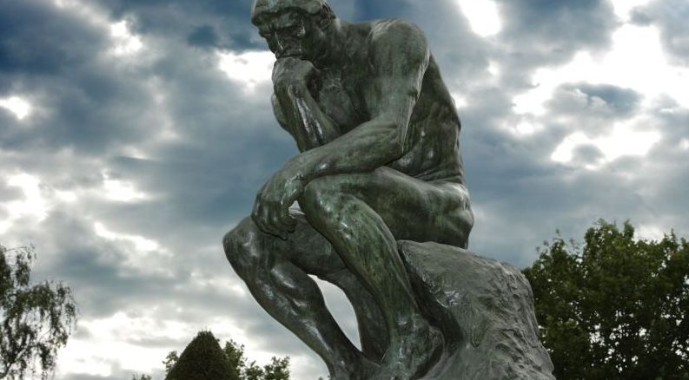
Pragmatic reasons to practice mindfulness:
This Photo by Unknown Author is licensed under CC BY
1. To reduce worry about the future and rumination about the past.
2. To enhance the present by noticing what is good.
3. To increase acceptance of the present.
4. To reduce stress and self-soothe.
5. To return to core values.
Notes:
Broad to specific
1. To reduce worry about the future and rumination about the past.
Mbct, rumination, mental disorders; stop worrying about the river; focus on the bowl of oil; really clarifies the two
2. To enhance the present by noticing what is good.
Behaviorism, broaden and build, gestalt and cat; enjoying the breath
3. To increase acceptance of the present.
does not mean just tolerating horrible conditions.
letting go of unrealistic efforts to change
radical acceptance
Epictetus and loving the river for what it is
4. To reduce stress and self-soothe.
Mindful breathing
5. To return to core values-in-action.
Return to deepest values
awaken from bad habits
Next we will go to practical applications, but first:
QUESTIONS

Slide 4
What is mindfulness?
What it looks like: Typically, when we define mindfulness, we say something like this quote from Jon Kabatt-Zinn: “Mindfulness means paying attention in a particular way: on purpose, in the present moment, and nonjudgmentally” (p. 4).
Spirit: an ancient practice for dealing with impermanence.
Practice: mindful breathing exercise
Jon Kabatt-Zinn brought mindfulness into the realm of empirical interventions. Where did he get it from? Why did he think it was relevant?
Notes:
Typically, when we define mindfulness, we say something like this quote from Jon Kabatt-Zinn: “Mindfulness means paying attention in a particular way: on purpose, in the present moment, and nonjudgmentally” (p. 4).
Modern, practical definition of mindfulness.
Historically, buddhist practice. More later—the raft in the river.
Practically: mindful breathing exercise

Slide 5
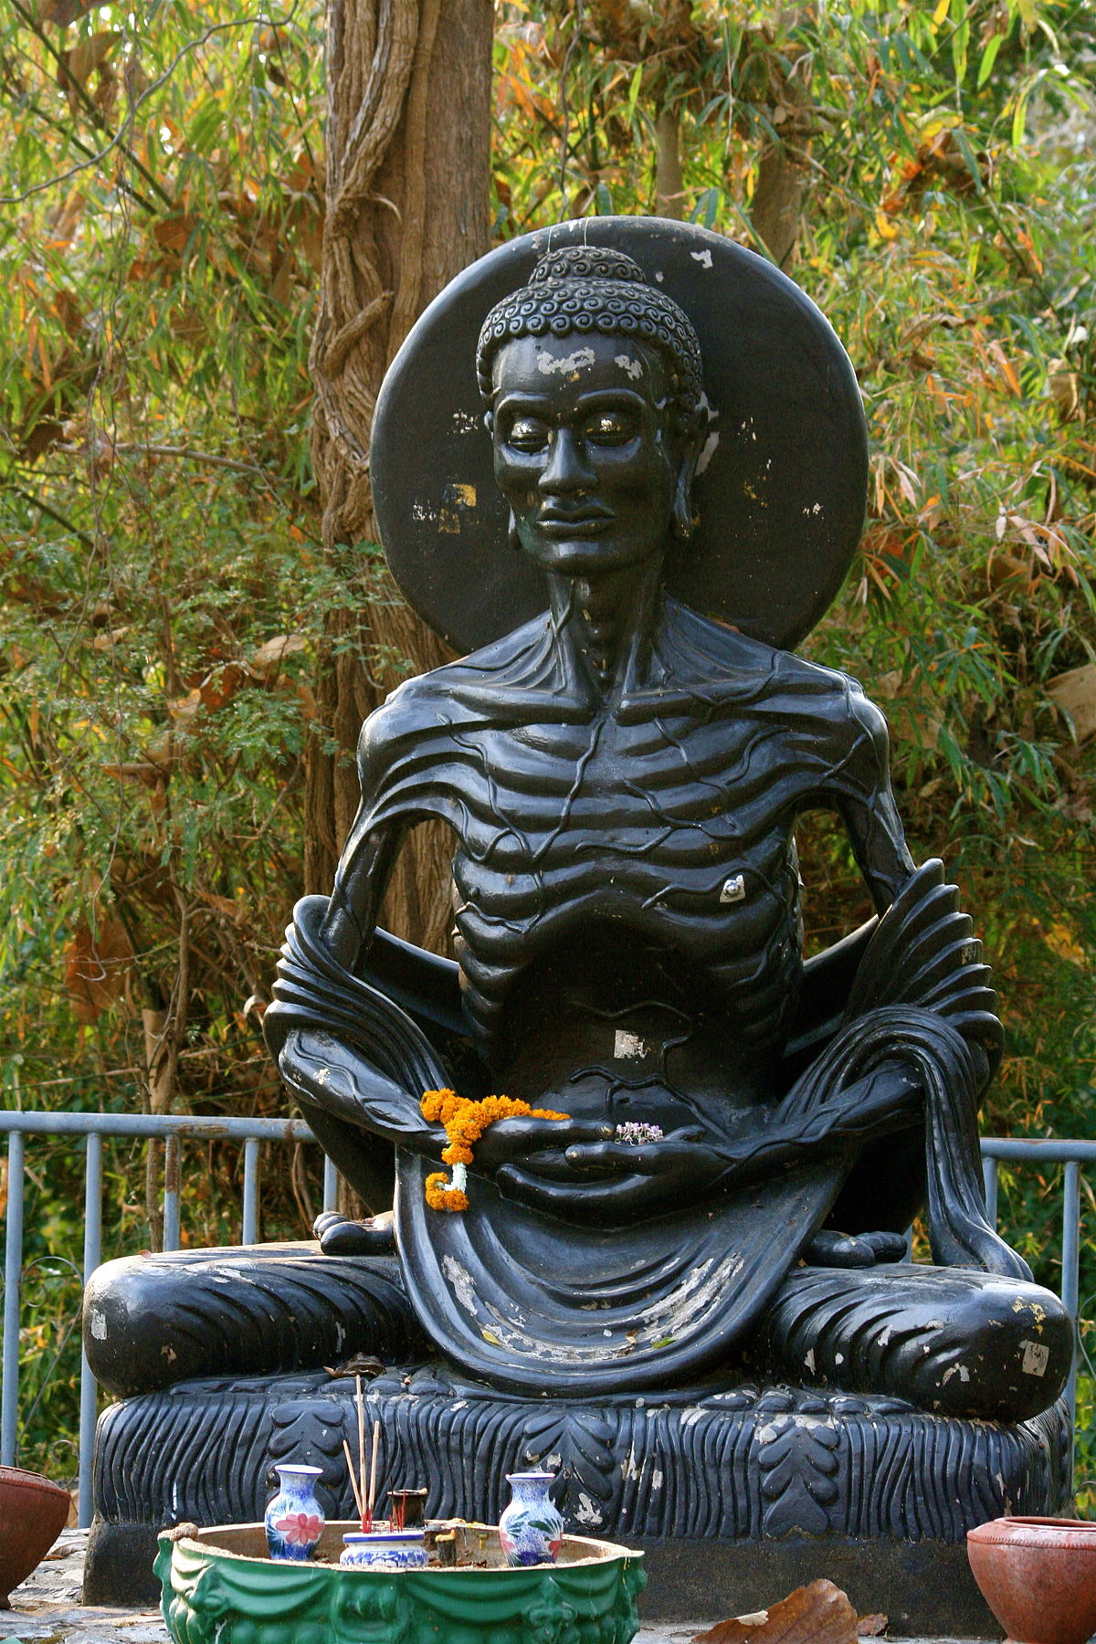
Mindfulness in Buddhism
Suffering caused by craving for permanence and certitude in what is impermanent and uncertain (e.g., wanting the river to be a boardwalk)
The Foundations of Mindfulness: contemplating death and breath (recognizing the river and returning to the raft)
Mindfulness = an intense, life-or-death return to the present—carrying the bowl of oil
This Photo by Unknown Author is licensed under CC BY-SA
Notes:
Mindfulness was developed in the context of Buddhism
River and the raft
Satipatthana: death (the river) and breath (the raft), seeing the river (acceptance) and steering the raft (returning to our valued action)
Def: Bowl of oil
Five contemplations. Here’s the river: “‘I am subject to aging,… I am subject to illness … I am subject to death …I will grow different, separate from all that is dear and appealing to me.’” (AN 5.57). Here’s the raft: “‘I am the owner of my actions, heir to my actions, born of my actions, related through my actions, and have my actions as my arbitrator. Whatever I do, for good or for evil, to that will I fall heir.’”
Life is a raft on a river deal

Slide 6
Questions!
In a minute we will go on to some practical applications of mindfulness, but let’s take a moment to answer some questions about what has come up so far.

Slide 7
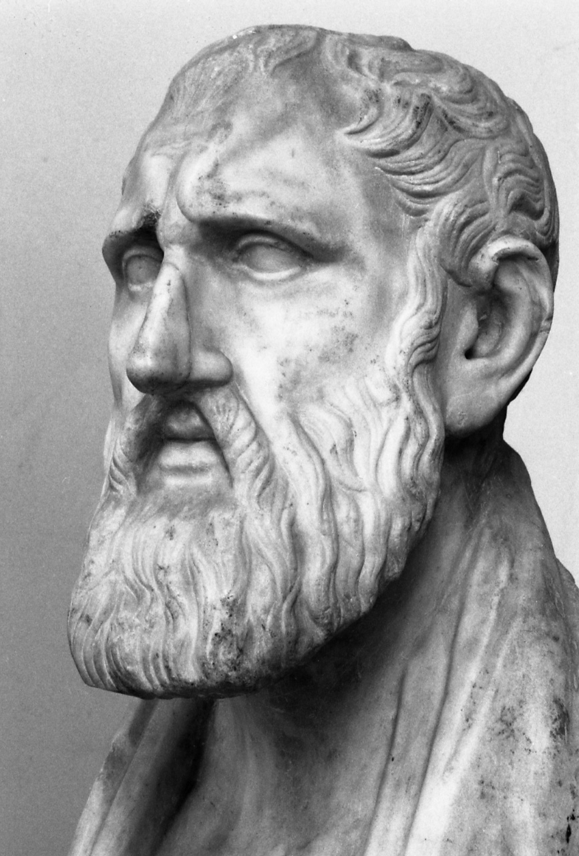
The raft and river in other ancient philosophical traditions: Epictetus
“Of all existing things, some are in our power, and others are not in our power” (Enchiridion 1)
We control our raft but not the river around us.
We have freedom through investing our mental and emotional energy in what we can control.
This Photo by Unknown Author is licensed under CC BY-SA
Notes:
The raft on a river principle is not unique to Buddhism
Epictetus: “Of all existing things some are in our power, and others are not in our power. In our power are thought, impulse, will to get and will to avoid, and, in a word, everything which is our own doing. Things not in our power include the body, property, reputation, office, and, in a word, everything which is not our own doing. Things in our power are by nature free, unhindered, untrammelled; things not in our power are weak, servile, subject to hindrance, dependent on others” (Enchiridion 1).
Clearly distinguishing the raft and the river and saying focus on the raft—don’t spend your time trying to control the river!
Similar to Buddhism: “Do not seek to have events happen as you want them to, but instead want them to happen as they do happen, and your life will go well” (Enchiridion 8).
To put it different: love (or accept) the river for what it is and use your raft

Slide 8
The raft and river in other ancient philosophical traditions: Ecclesiastes
“All of it is meaningless, a chasing after the wind” (Ecclesiastes 2:17)
Because of death and impermanence, life seems meaningless.
Yet human beings have the power to love, enjoy, and work.
This Photo by Unknown Author is licensed under CC BY-NC-ND
Notes:
The writer of the Hebrew book of Ecclesiastes, after reflecting on his mortality, writes: “So I hated life, because the work that is done under the sun was grievous to me. All of it is meaningless, a chasing after the wind (Ecclesiastes 2:17).
Powerlessness—chasing after the wind like holding the current in your hand
The author proceeds to a similar conclusion as Epictetus: “Enjoy life with your spouse, whom you love, all the days of this meaningless life that has been given you under the sun—all your meaningless days. For this is your lot in life and in your toilsome labor under the sun. Whatever your hand finds to do, do it with all your might, for in the realm of the dead, where you are going, there is neither working nor planning nor knowledge nor wisdom” (Ecclesiastes 9:10).
This even sounds like mindfulness: that bowl of oil definition—bringing an intense awareness to the present action—with all your might.
Talking about enjoyment, values—living more deeply.

Slide 9
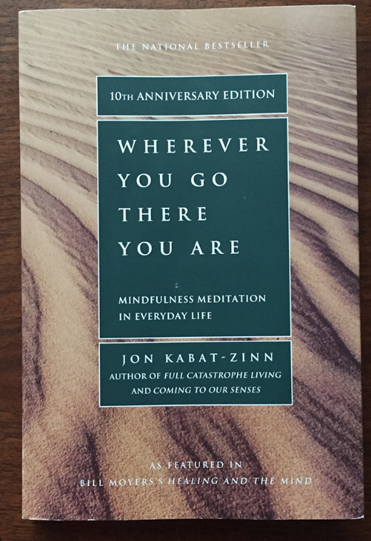
Mindfulness in present-day mental health:
Mindfulness-Based Stress Reduction
Chronic pain
Paying attention, accepting, and living fully
Dialectical Behavior Therapy
The dialectic: acceptance vs. change
Emotional dysregulation vs. mindful participation
Acceptance and Commitment Therapy
Values in action
The serenity prayer
Notes:
These basic themes can be seen today in mindfulness-based mental health treatments
As noted earlier, Jon Kabatt-Zinn defined mindfulness as follows: “Mindfulness means paying attention in a particular way: on purpose, in the present moment, and nonjudgmentally. This kind of attention nurtures greater awareness, clarity, and acceptance of the present-moment reality. It wakes us up to the fact that our lives unfold only in moments. If we are not fully present for many of those moments, we may not only miss what is most valuable in our lives but also fail to realize the richness of the depth of our possibilities for growth and transformation” (1994, p. 4).
The same river-raft relationship—notice how he talks about seeing the river in the present.
In dialectical behavior therapy, Marsha Linehan present mindfulness as an essential mental health skill (Linehan, 201).
Observe, describe, participate, one-pointed, effectively
pervasive emotional dysregulation and chaos balanced with effective action
acceptance and commitment therapy, referred to as ACT.
Serenity prayer
Values in action (raft-focused action)
Same theme throughout history: raft on a river; when you see the river for what it is, you can stop fighting it and focus on navigating it.
If we are suffering, chances are we are trying to control the river and not the raft.

Slide 10
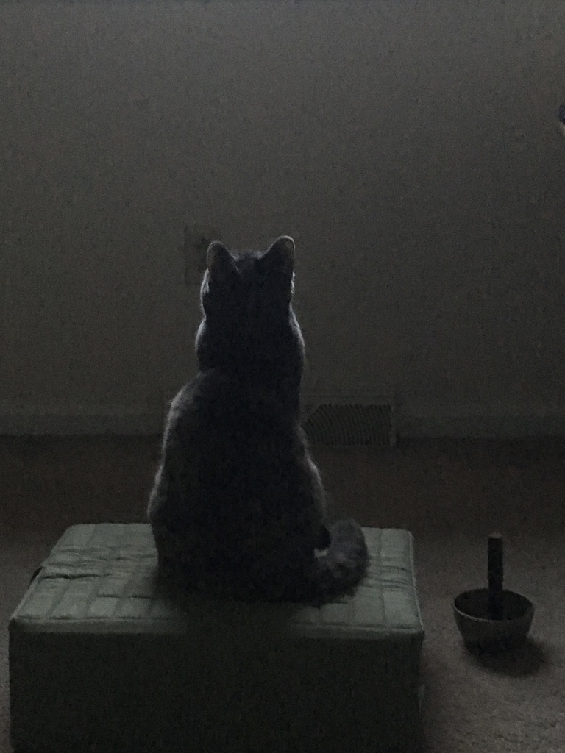
Practical Application
How the spirit translates to practice.
In practice, our focus is on learning to pay attention on purpose.
Three mindfulness exercises (see handout):
Sitting meditation
Paying attention to the present task
Mindful pausing
Notes:
All that being said, you hopefully have an idea of what mindfulness is and what issues it was designed to address. However, I would like to now proceed to the part of the presentation in which you can experience mindfulness and then use it in your life.
Mindfulness practice may have a different flavor from mindfulness as I have described it so far. As I have said, the goal of mindfulness is to accept what cannot be controlled and invest in what can be controlled. The problem is this can be difficult to do. The mind gets worked up into thinking about problems that can’t be solved—what we call rumination—and prevents us from engaging with what can be solved in the present. Because the mind can be like this and easily wander, a large component of mindfulness practice involves learning to manage our attention.
For this part of the presentation, I am going to introduce three types of mindfulness practice: sitting meditation, focusing on the present task, and mindful pausing. I will ask you to participate in the sitting meditation exercise. However, please participate as you are comfortable and feel free to stop the exercise at any time.
Sitting Meditation
1. Go to a place where you can sit in relative privacy and quiet.
2. Sit in a comfortable position, either in a chair or on a cushion. If you are sitting without back support, make sure to sit with your knees lower than your pelvis and with your spine naturally curved but not rigid. Once you take your sitting position, try to maintain it for the length of the meditation.
3. Set a timer for 5-20 minutes or however long you choose to sit.
4. Pay attention to the sensations of breathing at the nostrils or abdomen. Let the breath flow naturally. Notice the sensations of breathing in; notice the sensations of breathing out. Closely follow these sensations from the beginning of the inhalation to the end of the inhalation, from the beginning of the exhalation to the end of the exhalation. Focus on one inhalation at a time, one exhalation at a time. When you notice the mind has wandered, just return to the sensations of breathing. Whatever thoughts or feelings arise, give yourself permission to let them be. You do not need to fight them, change them, or push them away. They can just come and go. This non-resistance to your inner experience is the practice of accepting whatever arises in the moment.
5. If you have difficulty maintaining focus, try counting your breaths mentally. As you inhale, count “one.” As you exhale, count “one.” On the next breath, count “two” on the inhalation, “two” on the exhalation, and so forth up to 5. When you complete five breaths, start over again from the beginning.
Focusing on the Present Task
In brief, focusing on the present task means just that: being present to whatever you are doing. Here are steps for how to practice:
1. As you are going about your normal activities, remember your intention to be present.
2. Pay attention to the sensations of whatever you are doing. If you are walking, notice what it feels like to walk. If you are sitting, notice what it feels like to sit, etc.
3. If there is any muscle tension, try to relax it if possible.
4. Notice what it feels like to move your body in this moment. To stay anchored, keep your movements deliberate and relaxed.
5. When you notice your mind has wandered, just bring your attention back to your body and the present task. If it is helpful, use a word like “present” or “here” to bring yourself back.
6. If you are struggling to focus, try anchoring your attention to the breath.
Mindful Pausing
Pausing means taking a moment to breath mindfully throughout the day. Whenever you have a chance, or at regular intervals (for instance, at the top of the hour), stop what you are doing and take 1 to 3 mindful breaths. For this brief time, give yourself the freedom to really just be present with your breath and body.

Slide 11
Mindfulness Resources
Websites
Palouse Mindfulness https://palousemindfulness.com/index.html
Greater Good Science Center https://ggia.berkeley.edu/
Apps
UCLA Mindful
Headspace
Oxford MBCT
Books
Lehrhaupt, L., & Meibert, P. (2017). Mindfulness-based stress reduction: a program for enhancing health and vitality.
Williams, M., & Penman, D. (2011). Mindfulness: an eight-week plan for finding peace in a frantic world.
Kabat-Zinn, J. (1994). Wherever you go, there you are.
This Photo by Unknown Author is licensed under CC BY-SA
Notes:
Websites
Palouse Mindfulness https://palousemindfulness.com/index.html
Greater Good Science Center https://ggia.berkeley.edu/
Apps
UCLA Mindful
Headspace
Oxford MBCT
Books
Lehrhaupt, L., & Meibert, P. (2017). Mindfulness-based stress reduction: a program for enhancing health and vitality.
Williams, M., & Penman, D. (2011). Mindfulness: an eight-week plan for finding peace in a frantic world.
Kabat-Zinn, J. (1994). Wherever you go, there you are.

Slide 12
Review!
So hopefully now you know …
the definition of mindfulness
the raft on the river principle
how to practice mindful breathing
how to practice mindfulness at any time
how to take a mindful pause
what mindfulness can be used for (stress-reduction, acceptance, enjoyment, strengthening values)
Notes:
Know that mindfulness means paying attention, on purpose, without judgment.
Understand the relationship between mindfulness and uncertainty is about control: By being in the present, we can let go of what we don’t control—for instance, the laws of nature— and take hold of what we do control (our own actions). This is the raft on the river principle. We control the raft but not the river. The raft is our actions; the river is uncertainty.
Know how to practice mindful breathing by paying attention to the breath at the nostrils or abdomen while letting go of thoughts.
Know how to practice mindfulness at any time by paying attention to what it feels like to be doing whatever you are doing.
Know how to take a mindful pause by stopping what you are doing and focusing on your breathing for 1 to 3 breaths.
Know that practicing mindfulness can help you let go of worry and stress, accept life, enjoy life, and strengthen your core values.

Slide 13
Final Questions
Thank you for your time today! Please feel free to ask any questions.
Contact: Mark Chrisinger chriml18@wfu.edu

Slide 14
References
Kabat-Zinn, J. (1994). Wherever you go, there you are. New York: Hachette Books.

